Slide 1
Core Java
Andy Chen

Slide 2
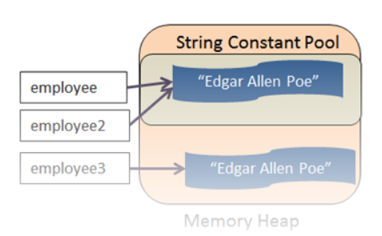
Topic: String constant pool
Constant pool is a heap memory for literal string value
New String will create a new heap memory
String employee = “Edgar Allen Poe”
String employee2 = “Edgar Allen Poe”
String employee3 = new String(“Edgar Allen Poe”)
Notes:
S1 == S2 ?
S1 == S3?
S1.equals(S3)?

Slide 3
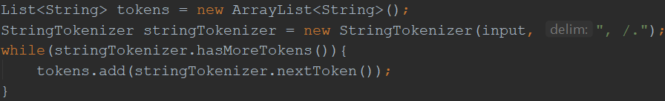
Topic : String
String is immutable
String str1 = “abc”; String str2 = new String(“abc”); String str3 = “abc”; String str4 = str1 + str2;
Reference vs Value: 1) str1 == str2 ? 2) Str1.equals(str2) ? 3) str1.compareTo(str2)
Constant Pool: How many objects ? (3)
Built-in Functions: charAt(), length(), substring(), contains(), equals(), toUpperCase()
StringBuilder & StringBuffer
StringBuilder sb = new StringBuilder(“abc”); sb.append(“abc”);
sb.append(“abc”); sb.reverse(); sb.delete(startIndex, endIndex)
Mutable
toString()
Synchronized vs non-synchronized
StringTokenizer

Slide 4
Topic: final
Variable :
public static final String APP_NAME=“testApp”
Purpose: define constants
Method:
public final int add(int a, int b){ return a + b; }
Purpose: prevent override
Class:
final class MyClass(){}
Purpose: 1) prevent inheritance, like Integer, String etc; 2) Make class immutable
Difference: final, finally, finalize

Slide 5
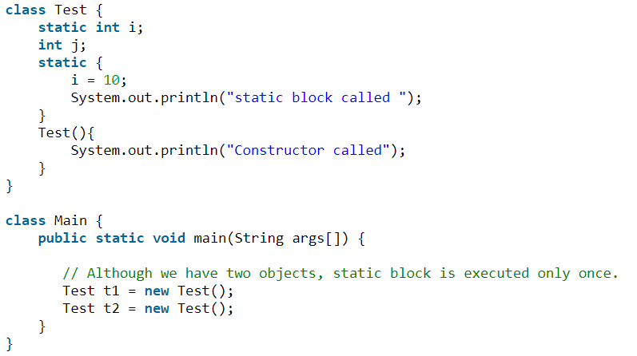
Topic: static
Blocks; Variales; Methods; Nested Classes
Only One Instance!
1) Static Block/Variable
Question
1. Java Variable Scope ?
2. scope of static block ?

Slide 6
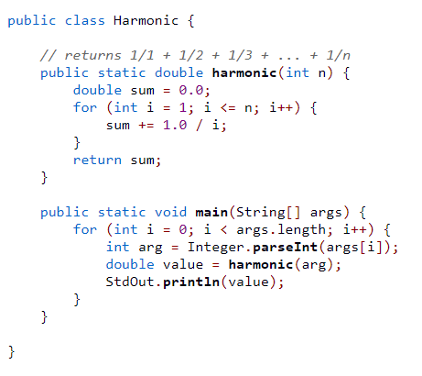
Topic: static
2) Static Method
Question:
1) Can static method access non-static variables ?
2) How to call static method in/outside of enclosing class?
3) Common Static Methods?
4) When to use static Methods?

Slide 7
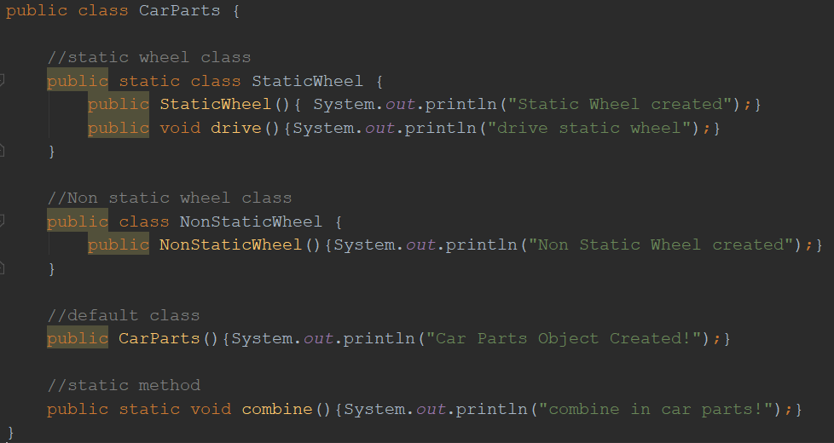
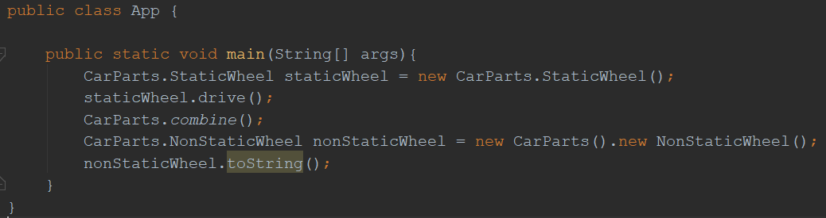
Topic: static
3) Static Class

Slide 8
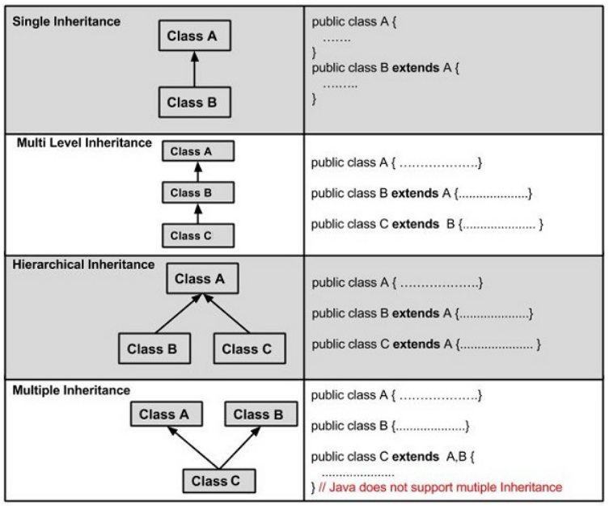
Topic: OOP(PIE)
Inheritance
Extends: Class
Implements: Interface
Question:
1. Abstract Class
2. Abstract class vs Interface
3. Marker Interface (Serialization)
Tips:
> Multiple Inheritance (extends) is not allowed
> Multiple Implementation (implements) is allowed
> Use “super()” to access parent class

Slide 9
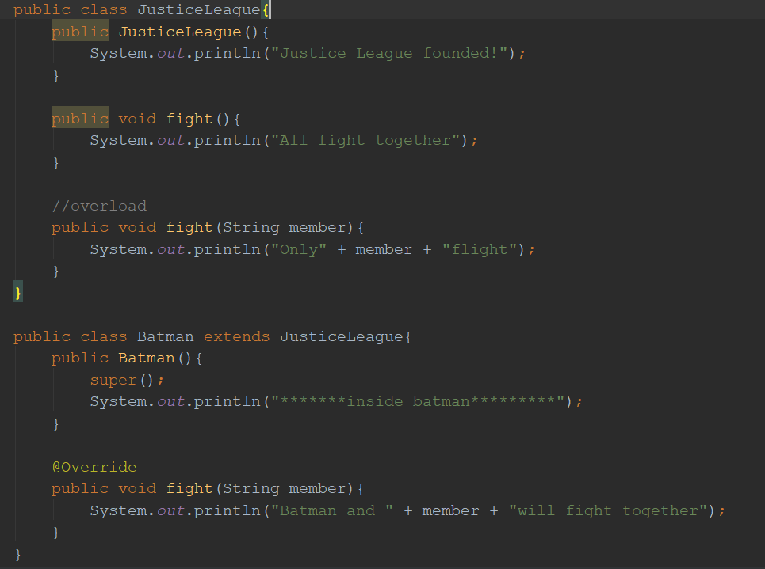
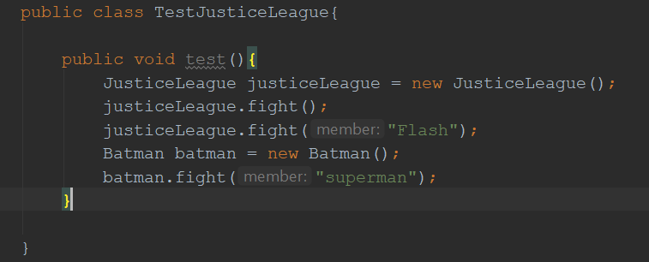
Topic: OOP(PIE)
Polymorphism
Static Polymorphism / Dynamic Polymorphism
Overload (same class) / Override (child class)
Question: output from test()

Slide 10
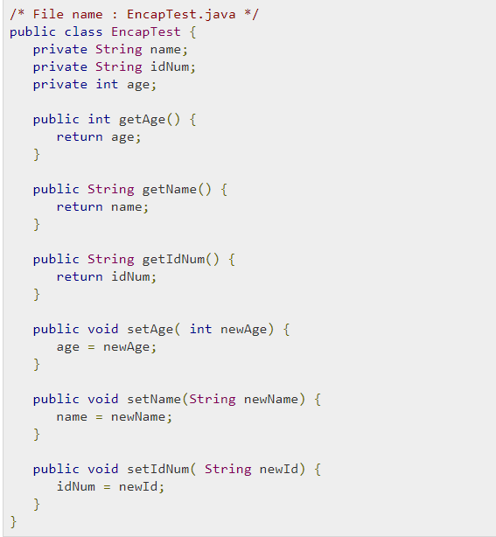
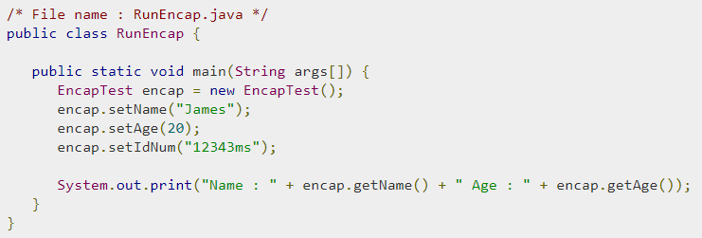
Topic: OOP(PIE)
Encapsulation
Tips: use getter/setter instead of direct access
Industry standard code structure
RTIME project walk through
(FrontEnd -> Controller -> Service -> DAO -> Database)

Slide 11
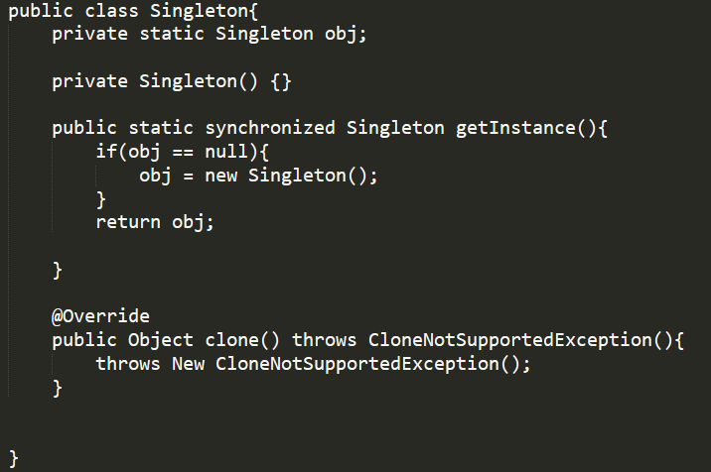
Topic: Design Pattern (Singleton)
Steps to make singleton
1. private Constructor
2. static getInstance method
3. synchronized
4. override clone() method
Disadvantage of Singleton
1. it carries state of object
2. it prevents dependency injection and cannot be unit tested
1
2
3
4

Slide 12
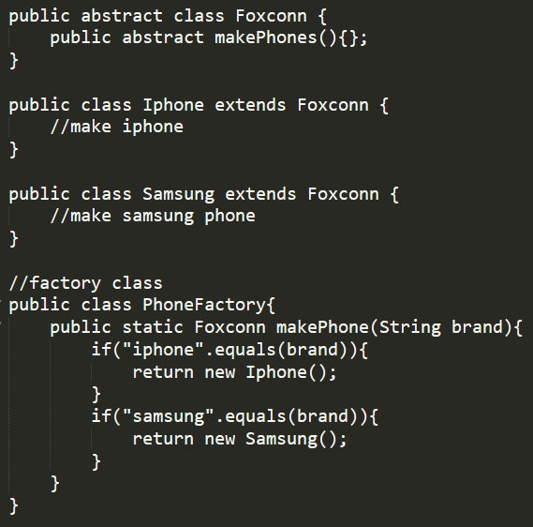
Topic: Design Pattern (Factory)

Slide 13
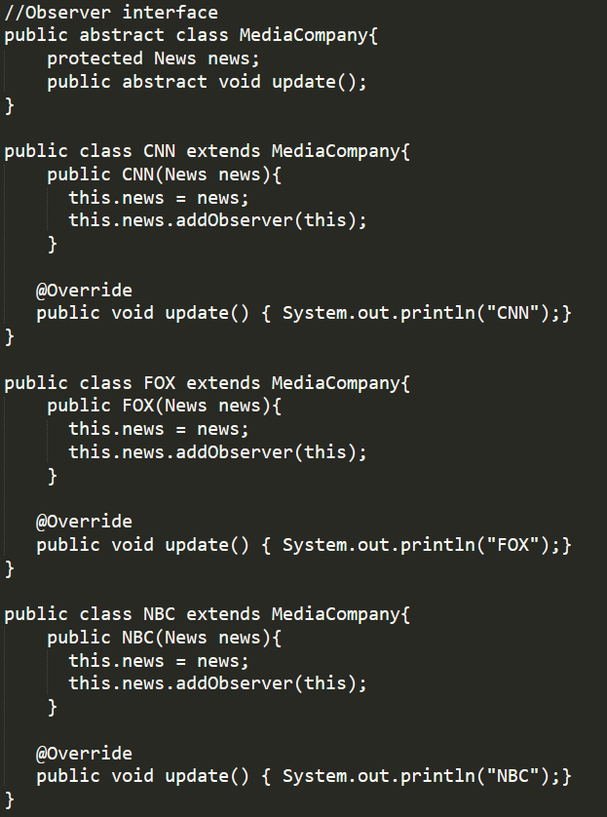
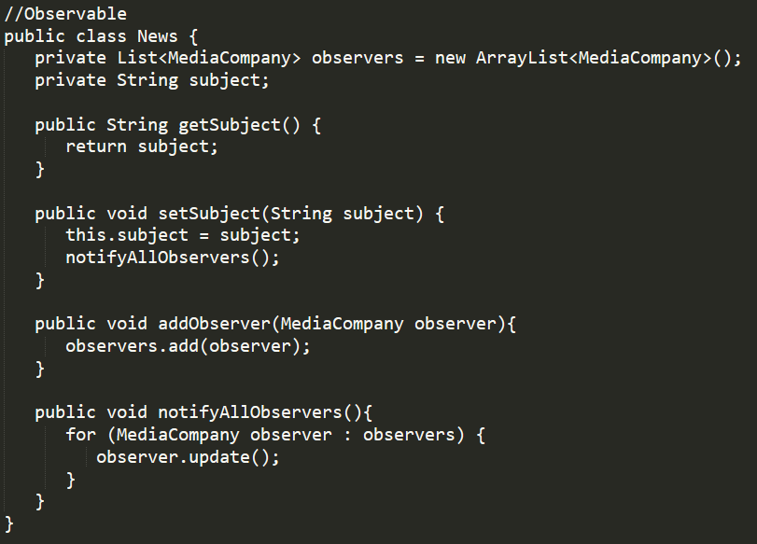
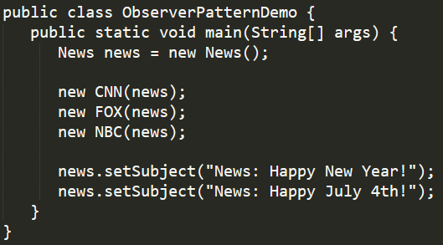
Topic: Design Pattern (Observer)
It is similar to “subscribe” in Angular/Redux and Reactive Programming

Slide 14
Topic: Design Pattern (Others)
Popular Design Pattern to choose:
Decorator, Façade, Strategy, Builder, Composite etc
DO NOT SAY “MVC”

Slide 15
Topic: Real Scenario
1. Design a Vending Machine
2. Design an Elevator System
Notes:
VendingMachine(List<> items, double balance, 1. getPriceForItem(), 2. vendingItem(), 3.insertPayment(), 4. refund() 5. Exchange())
Item(type, price)

Slide 16
Topic: Collections
List (Vector, ArrayList, Set, LinkedList)
HashMap, ConcurrentHashMap, TreeMap(comparator), HashTable
Principle of HashMap – How HashMap works
Equals() and HashCode()

Slide 17
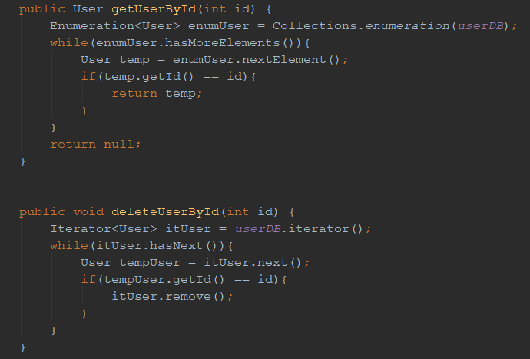
Topic: Iterator vs Enumeration

Slide 18
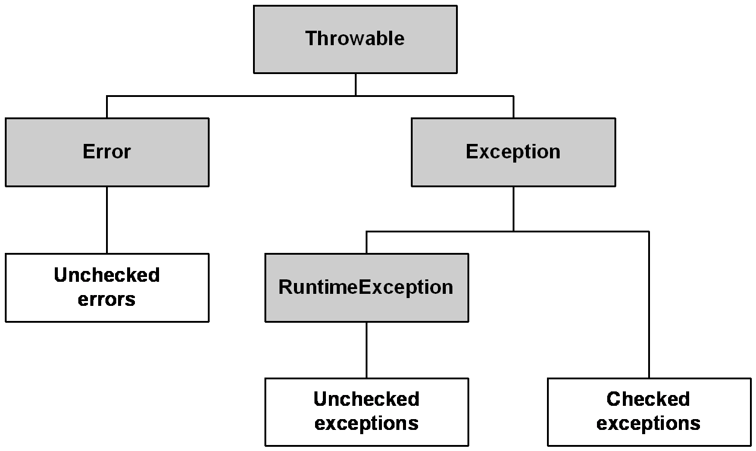
Topic: Exception Handling
See Example (rtime) project for customizing exception

Slide 19
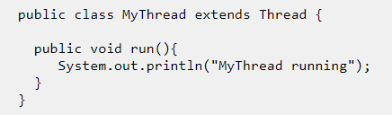
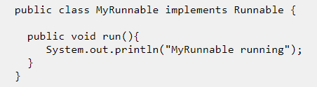
Topic: Multithreading
1. Create a thread
2. Thread vs Process
A: a process can contains multiple threads
3. Start() vs Run()
A: t.start() create and run a new thread. t.run() run the thread in current thread
4. sleep() vs wait() vs yield()
A: sleep() suspend current thread for given time. All other threads cannot run. This thread still occupies the lane.
wait() will suspend current thread and let other thread run. This thread only restart when hear notify()
Yield() suspend current thread. Other thread may run or may not. – rarely used.
5.ThreadLocal vs Volatile
A: threadlocal make object thread-safe, every thread gets its own copy, not shared.
Volatile objects is completely shared between threads

Slide 20
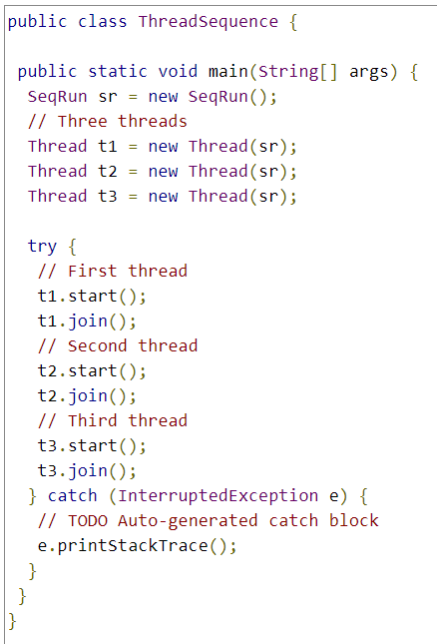
Topic: Multithreading
6. join(s) tells other threads to wait until this thread is completed or just wait for the given s seconds
7. Given three threads, how to let them run in order?

Slide 21
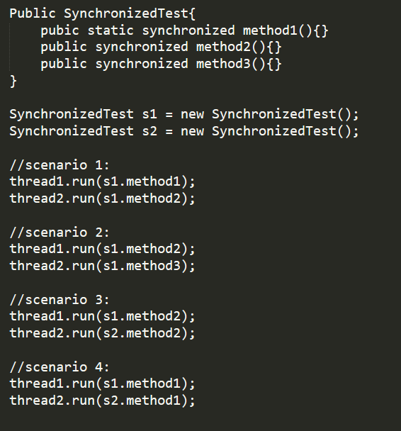
Topic: Synchronized
Synchronized lock on instance;
Static synchronized lock on class;
Analyze 4 scenarios:

Slide 22
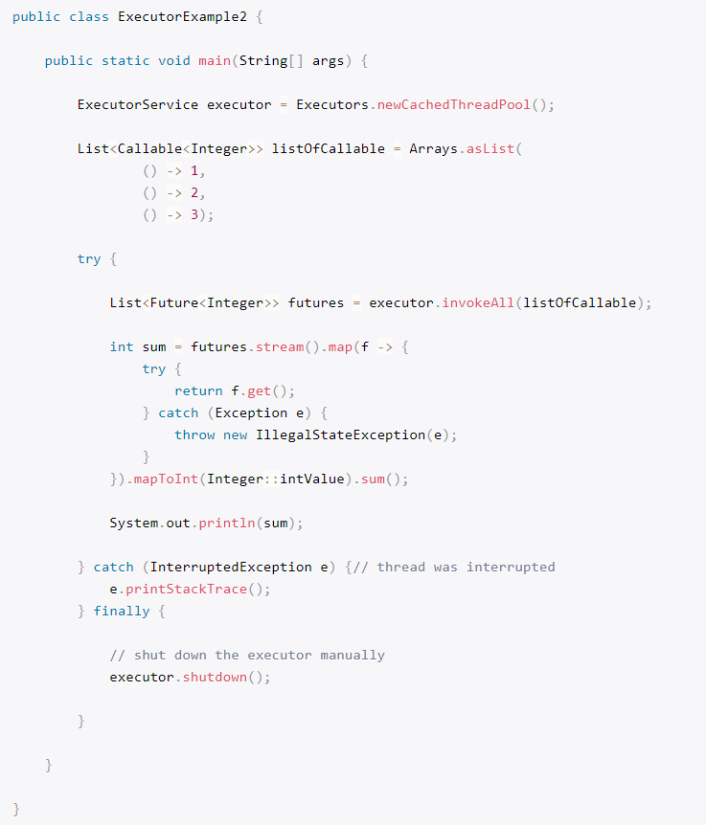
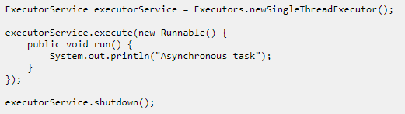
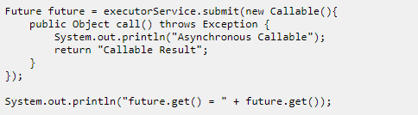
Topic: Concurrency -- 1) ExecutorService
ExecutorService maintains thread pool
Executors.newCachedThreadPool()
newFixedThreadPool()
Execute(), submit(), invokeAny(), invokeAll()
Runnable vs Callable
Future.get(*time), Future.isDone(), Future.cancel()
Executor.shutdown()
Notes:
newCachedThreadPool – thread will die if not been used for 60 seconds; NewFixedThreadPool – thread will exist forever
Execute(runnable) vs Submit(callable) – invoke(callable)
Future<String> future = executorService.submit();
String result = future.get(); ---------- use get() to get the object returned.
Remember to shutdown()

Slide 23
Topic: Concurrency -- 2) Semaphore and Mutex
package com.bht.aop.main;
import java.util.concurrent.Semaphore;
public class SemaphoreMain {
static Semaphore semaphore = new Semaphore(3);
//static Semaphore semaphore = new Semaphore(1);
static class MyATMThread extends Thread {
String name;
MyATMThread(String name){ this.name = name; }
public void run(){
try{
semaphore.acquire();
System.out.println(name + " : got the permit!");
try{
System.out.println(name + " is doing work now! ");
Thread.sleep(5000);
}finally {
System.out.println(name + " : releasing lock...");
semaphore.release();
}
}catch (InterruptedException e){e.printStackTrace();}
}
}
public static void main(String[] args) {
System.out.println("Total available Semaphore permits :" + semaphore.availablePermits());
MyATMThread t1 = new MyATMThread("A");
t1.start();
MyATMThread t2 = new MyATMThread("B");
t2.start();
MyATMThread t3 = new MyATMThread("C");
t3.start();
MyATMThread t4 = new MyATMThread("D");
t4.start();
MyATMThread t5 = new MyATMThread("E");
t5.start();
}
}
Semaphore – limits the number of threads to access one resource concurrently
Semaphore semaphore = new Semaphore(4)
Mutex – limits only 1 thread to access one resource concurrently
Mutex is not native in java, Semaphore(1) is Mutex
Notes:
New Semaphore(*) cannot be empty in constructor

Slide 24
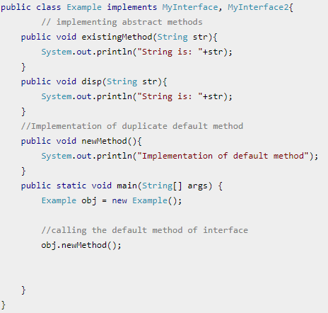
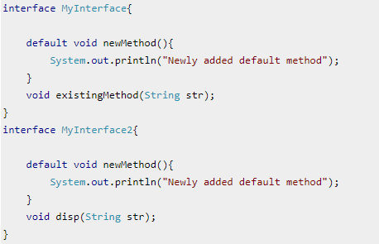
Topic: Java 8(default & static methods)
Problem with java interfaces: children must implements all methods in interface, if adding new definitions to interface, all children have to update.
Solution: default methods in interface
Problem: multiple implementations –> override
Static methods: the same as defaults method,
but does not allow override

Slide 25
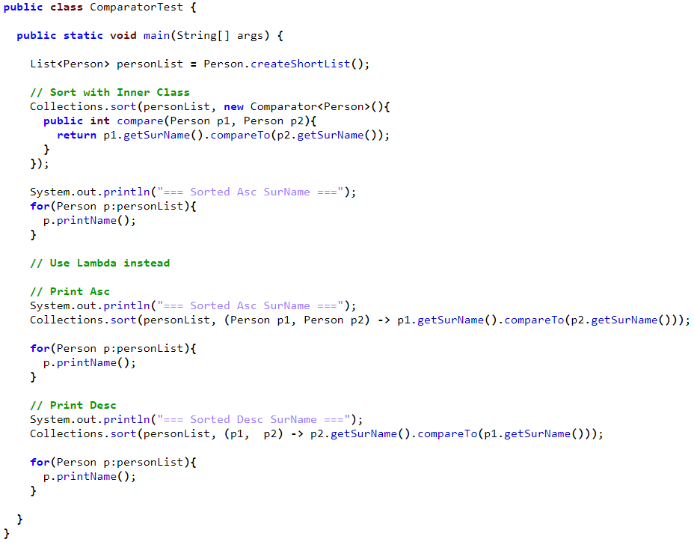
Topic: Java 8(lambda)
Why introducing lambda?
To replace anonymous inner class
Can rewrite any methods
Work with functional interface (next slide)
Scope of lambda:
Enclosing block
Tooltips:
Avoid large block of code and “return”
Avoid () around single input
Avoid input type

Slide 26
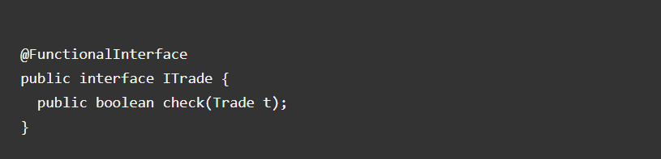
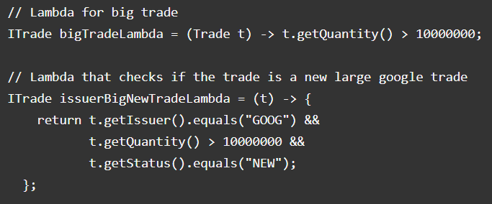
Topic: Java 8(Functional Interface)
has one Single Abstract Method
@FunctionalInterface – for sanity check
Can have default methods
Lambda is the implementation of the abstract method

Slide 27
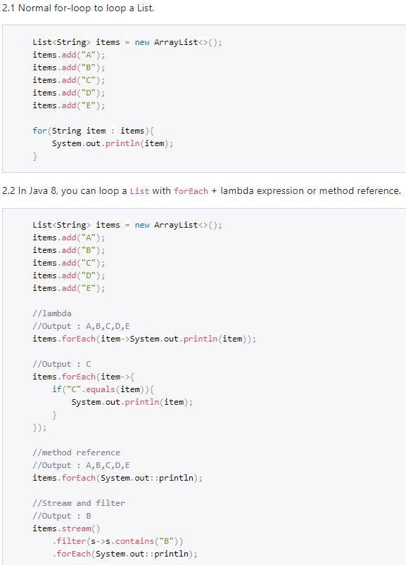
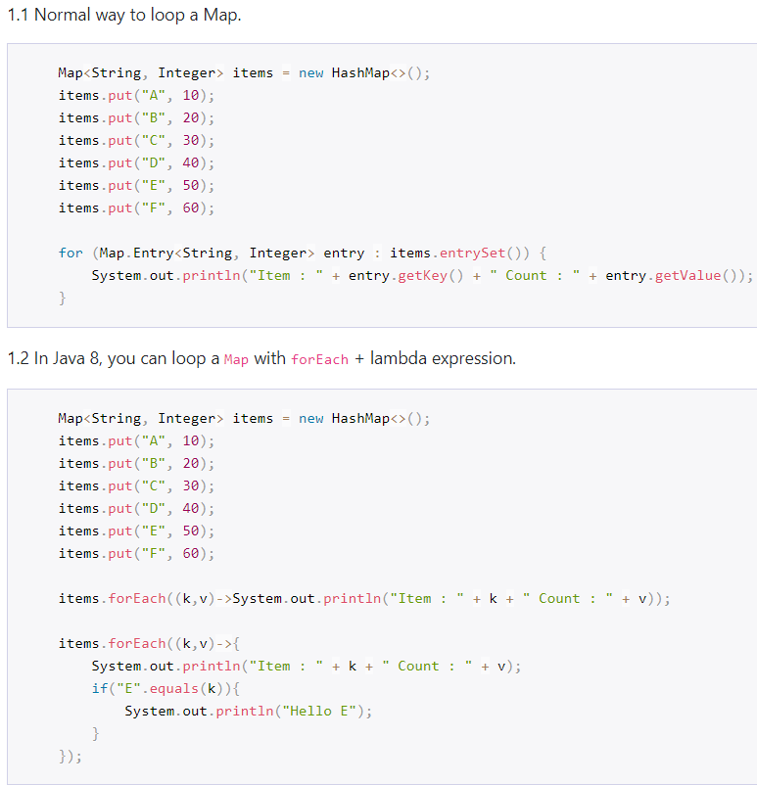
Topic: Java 8(forEach)

Slide 28
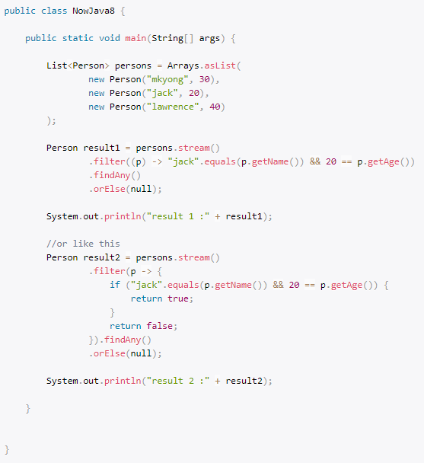
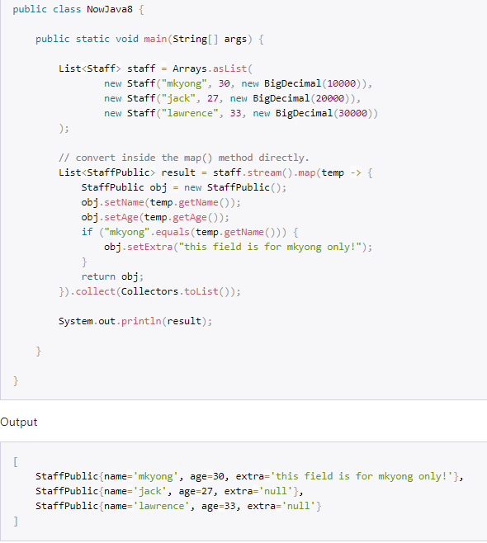
Topic: Java 8(stream)
filter map
Function
Predicate
Notes:
Predicate : a special function which only returns true or false – a judgement function

Slide 29
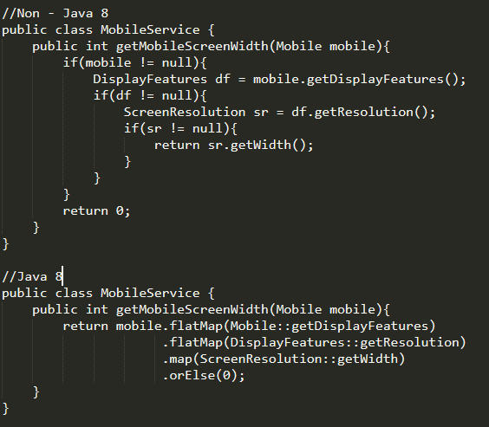
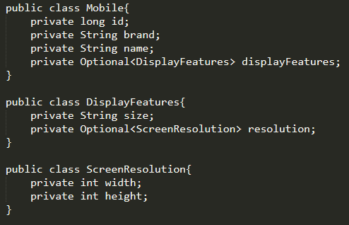
Topic: Java 8(optional)
To avoid Null checks and run time NullPointerExceptions

